Slide 1
Interstellar Polarization and Be stars
Presentation: Erick Powell
guidance: dr. Wisniewski

Slide 2
Be stars
B stars are main sequence stars that are fairly large and hot.
the e in Be means that at some point the star has shown Hα emission lines
These stars have circumstellar disk of gas surrounding them that can evolve over time.
Rapidly rotating
The tools we can use to observe the stars are:
Photometric measurements - Hα
Polarization (This project)

Slide 3
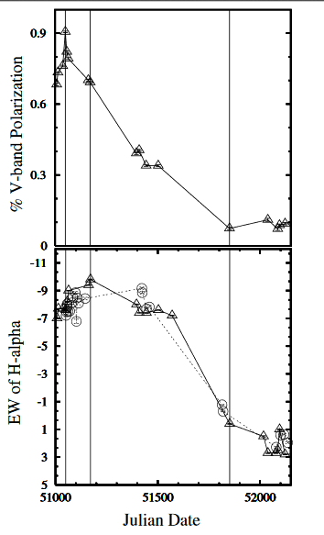
Motivation
Having cluster based Interstellar polarization allows us to follow the evolution of Be stars
Time series analysis of clusters with these stars will show how Be stars evolve.
Other viscous disks include:
Protoplanetary disks
Quasar accretion disks.
X
A Lot

Slide 4
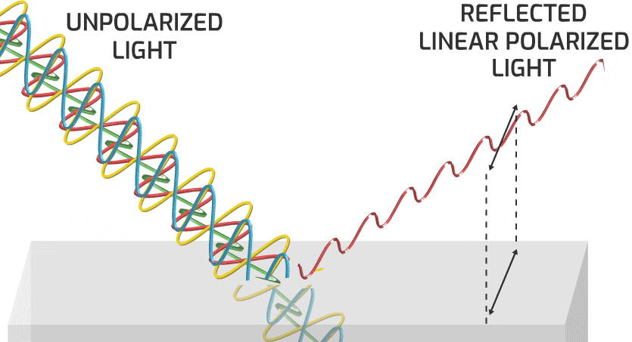
Polarization
The direction in which the electric field oscillates
Unpolarized light occurs in all rotations
Can be parametrized in four vectors (“Stokes Parameters”)
I, Q, U, and V
Specify the phase and polarization of electric field waves
Percent polarization
Lets us probe the outer part of the disk
Materials in the disk
Disk angle

Slide 5
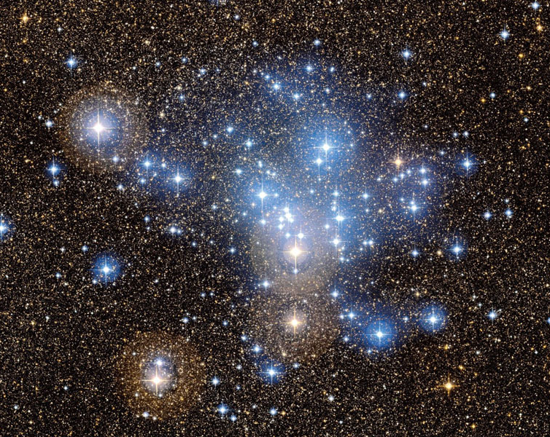
Interstellar Polarization
Biggest obstacle is isolating disk polarization
3 components to polarization
Disk
Interstellar Polarization
Telescope
An isolated polarization from the disk gives the most meaningful measurement
Stars in the same cluster have similar space to travel through (same Interstellar polarization)

Slide 6
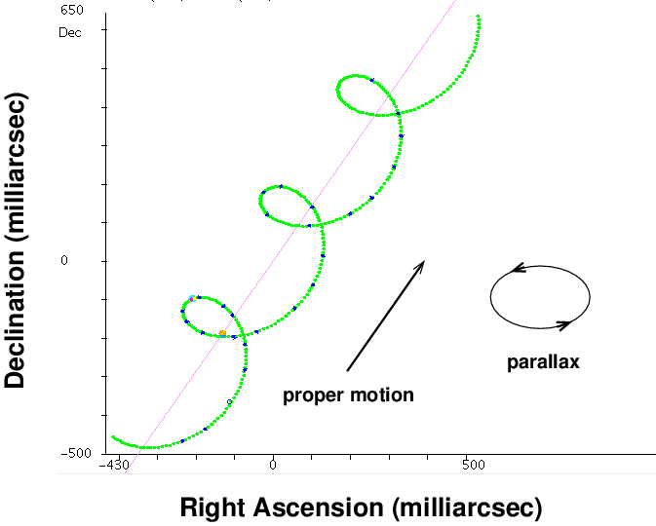
Parallax and Proper motion
Measurement of how much a star is moving relative to the background
Parallax can be used to determine the distance to the star
Proper motion can be used to determine the relative movements of stars
The two of these measurements can be used together to determine if stars are clustered together

Slide 7
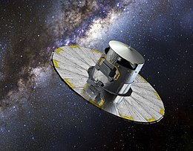
Cluster Membership
We end up observing stars that are not actually at the same distance as the cluster (Background or Foreground stars)
The distances to stars in an open cluster are normally distributed
By fitting a gaussian to the distances of stars matched from a catalog we can find a reasonable estimate of distance bounds
Combining this with a proper motion is how we do our final cut

Slide 8
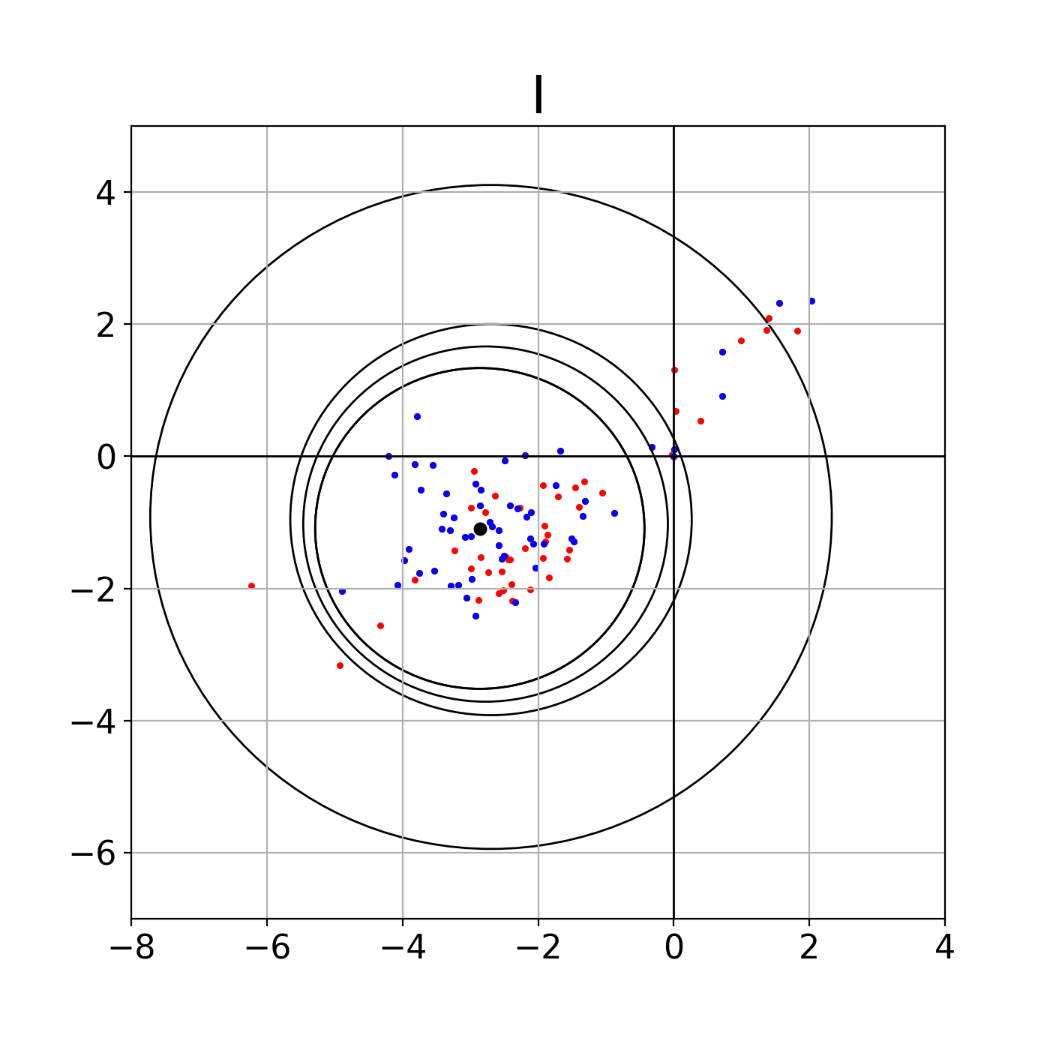
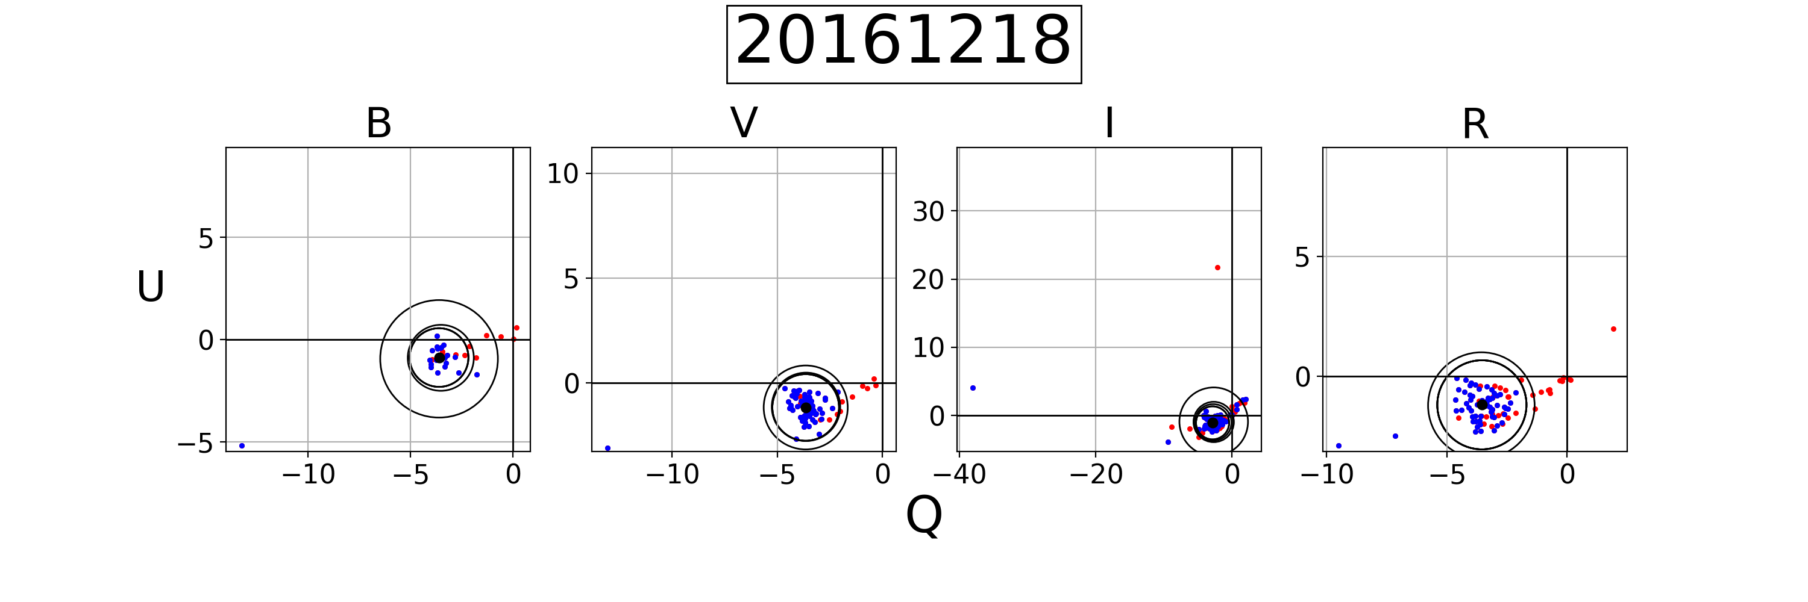
Clipping for the median
Stars within the cluster can still have their own polarization
Outliers influence the median less than the mean so the median polarization will characterize the ISP better.
Removing the points farthest away and recalculating the median gave a better measure still.

Slide 9
NGC 663
The first cluster the group looked at because it has a large portion of Be stars
Spent a lot of the time developing the frame work that we will be able to apply to the other 16 clusters
This led us to the first two complications to the process

Slide 10
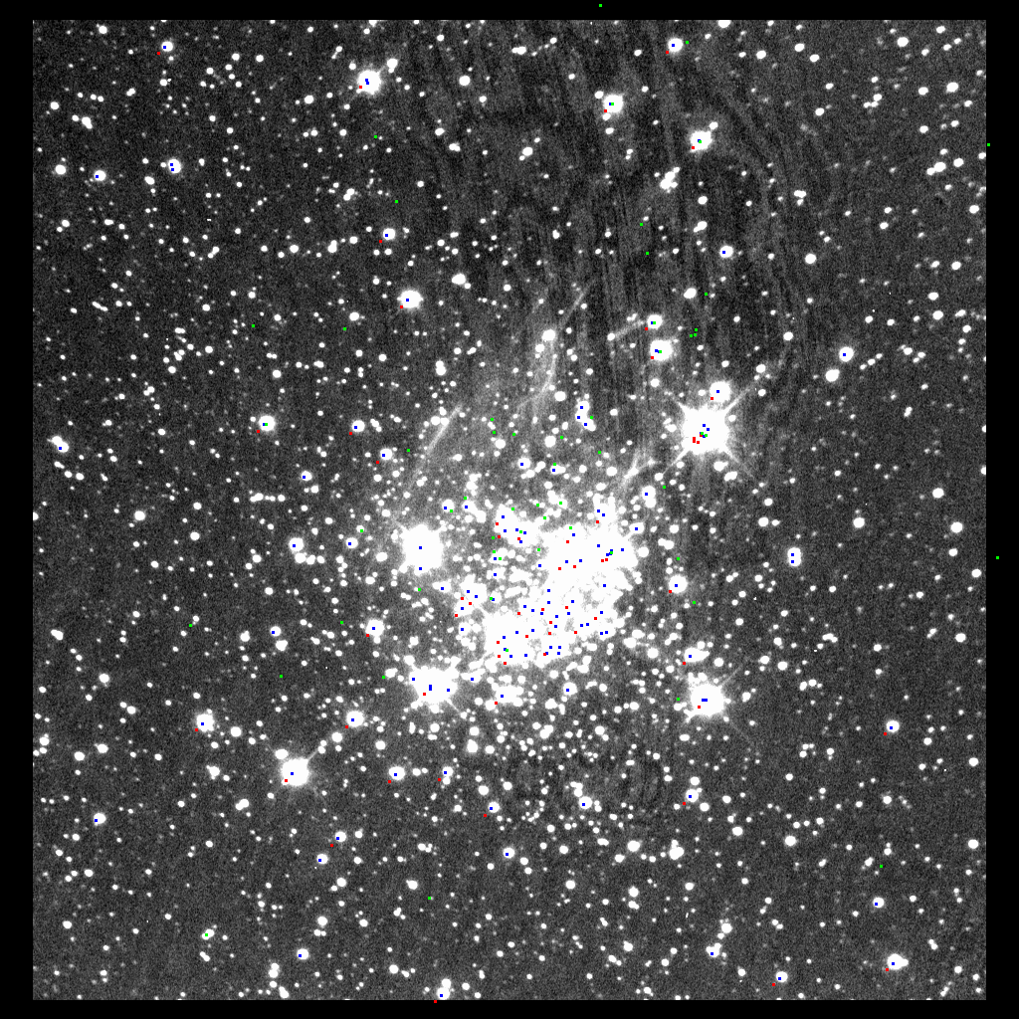
Should over lap exactly
Causes problems when we want to identify the stars we observe
Solution is to go through each of the images and txt files and manually find the offsets to apply to each of the x ,y values

Slide 11
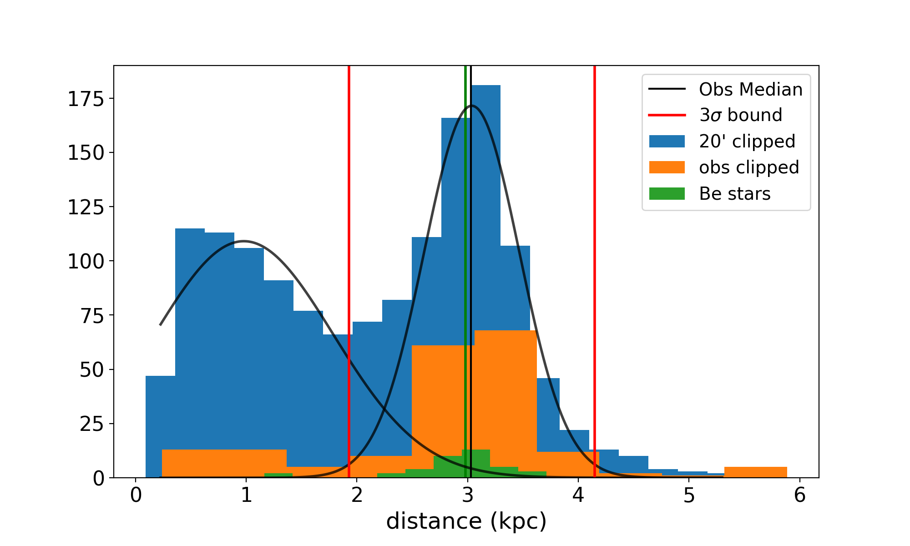
Membership complication
Literature has suggested that the distance to the cluster is 2.4kpc (Pandley,2005)
However when querying a 20’ radius around the cluster we find that there are two populations, a foreground population and what we believe is the cluster at 3kpc
This difference would significantly change the median of the cluster

Slide 12
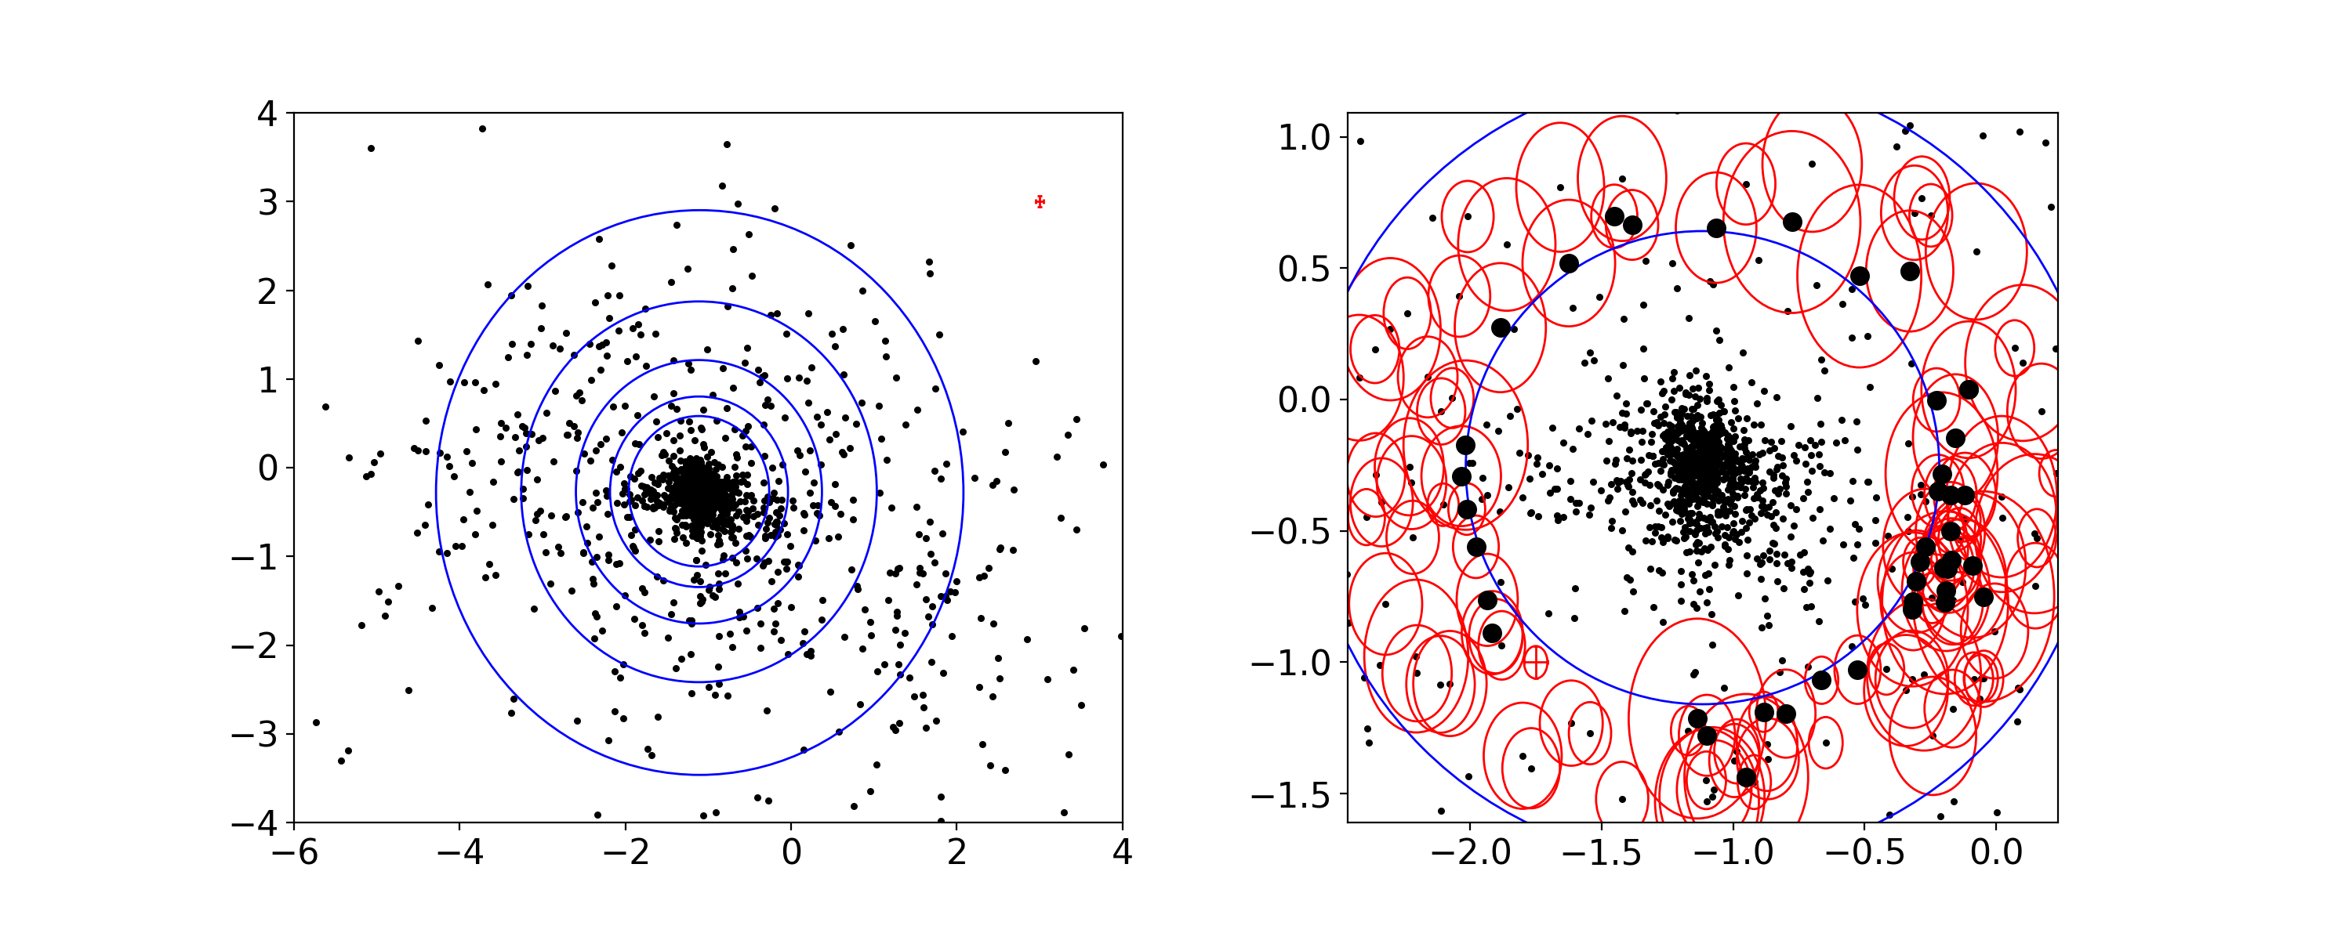
Proper Motion cuts
To determine the final membership we need to make proper motion cuts
To properly cut the proper motions we looked at the points in 2d space
Similar to the cut we did with QU, the cut is based on the distance from the median value.
After the final cut we had to consider if the error ellipse’s fell into the final region
PM Dec
PM RA

Slide 13
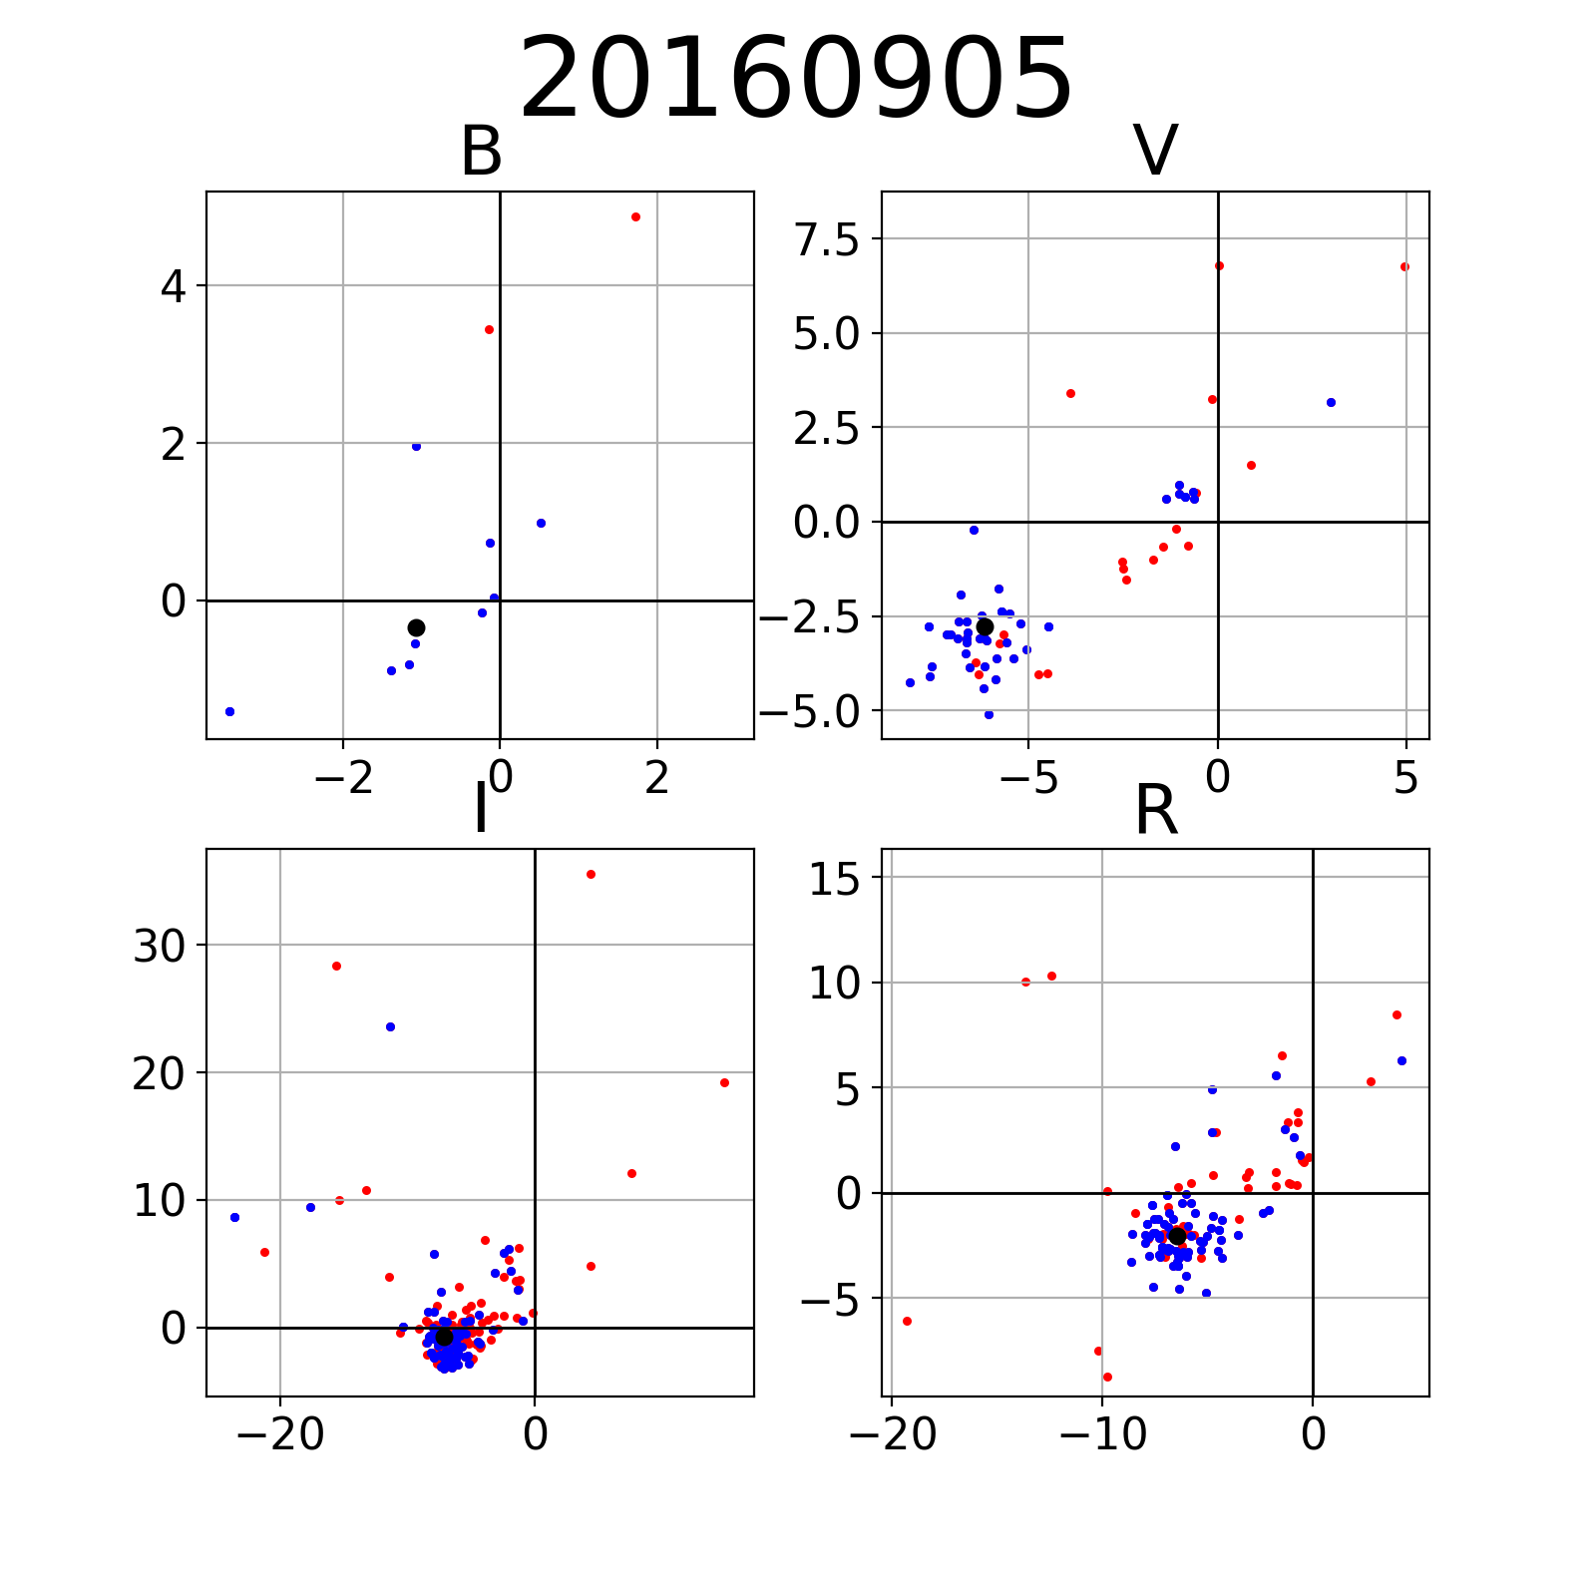
NGC 7419
Our group did not have as much time with NGC 7419 so we still have a few problems to fix
Our Cross Matching is still a problem that we deal with manually

Slide 14

Future Work
NGC 663 has everything needed to look at polarization
Individual star based
Find polarization of stars of a given cluster
Compare change in disk size of many stars
The rest of the clusters
Find ISP to different clusters
Compare ISP of different clusters

Slide 15
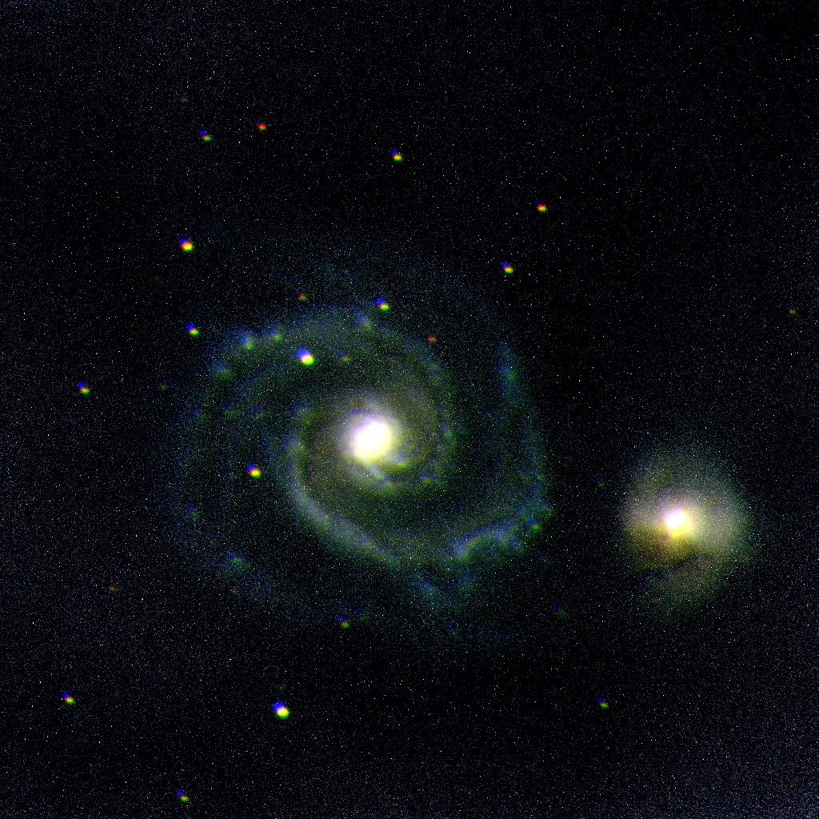
Questions?

